Slide 1
Retain Your Rain Program

Slide 2
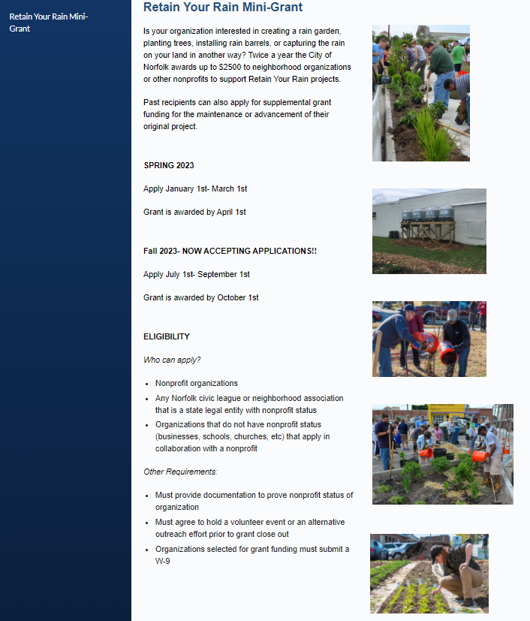
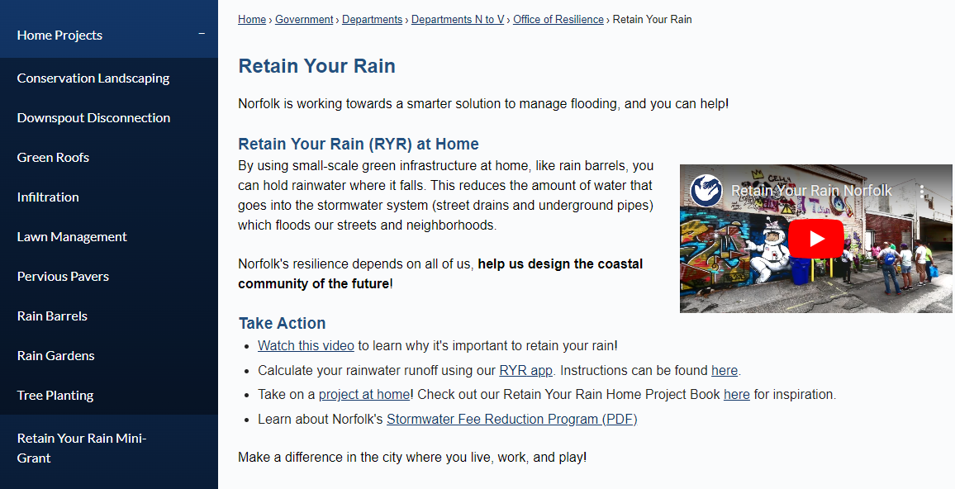
RYR Website
https://www.norfolk.gov/3700/Retain-Your-Rain

Slide 3
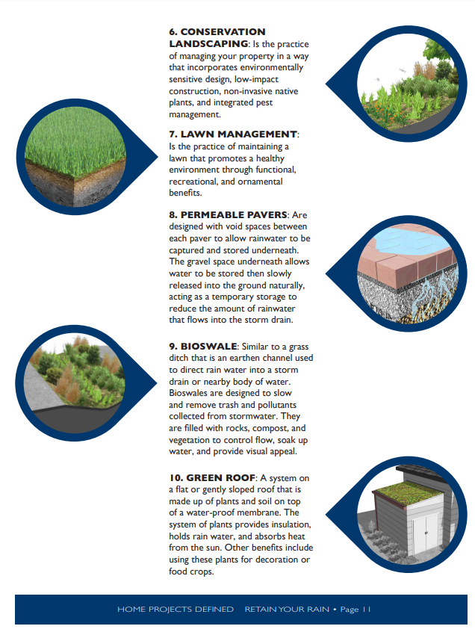
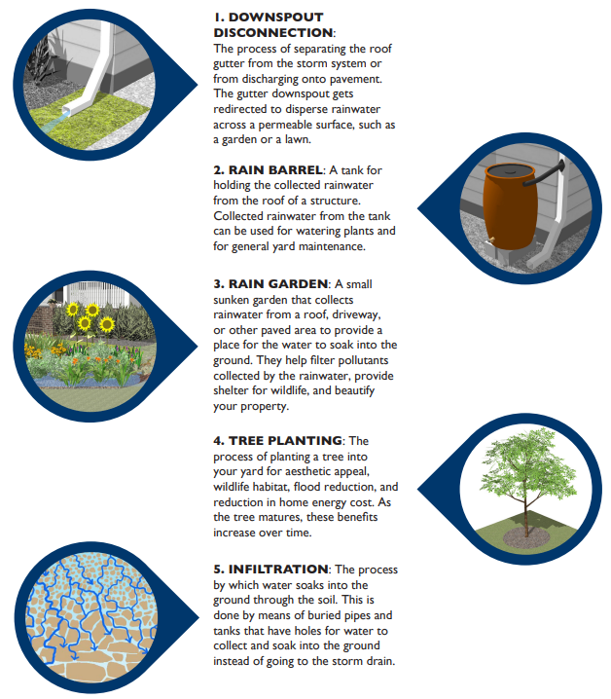
RYR Home Projects

Slide 4
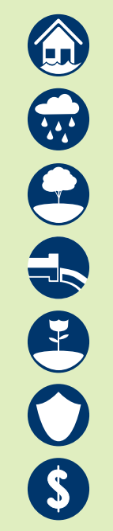
Benefits
Help mitigate storm and flood damage to your property in addition to mitigating flooding throughout the city of Norfolk
Storing water on your property to use for your plants or for other activities, instead of using city water.
Trees provide beauty, habitat, absorb heat, produce oxygen, drink up lots of water, and when placed appropriately, reduce heating/ cooling costs of your home throughout the seasons
Plants provide beauty, food for pollinators, habitat, add value to your property, absorb and break down pollutants.

Slide 5

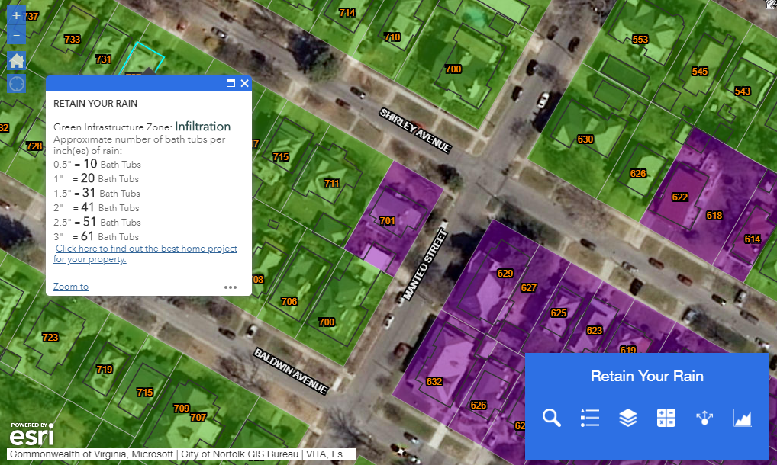
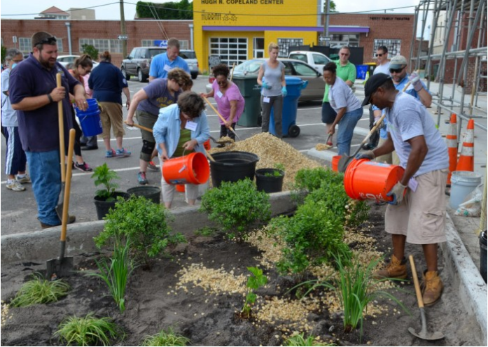
Community Resilience – Doing Your Part

Slide 6
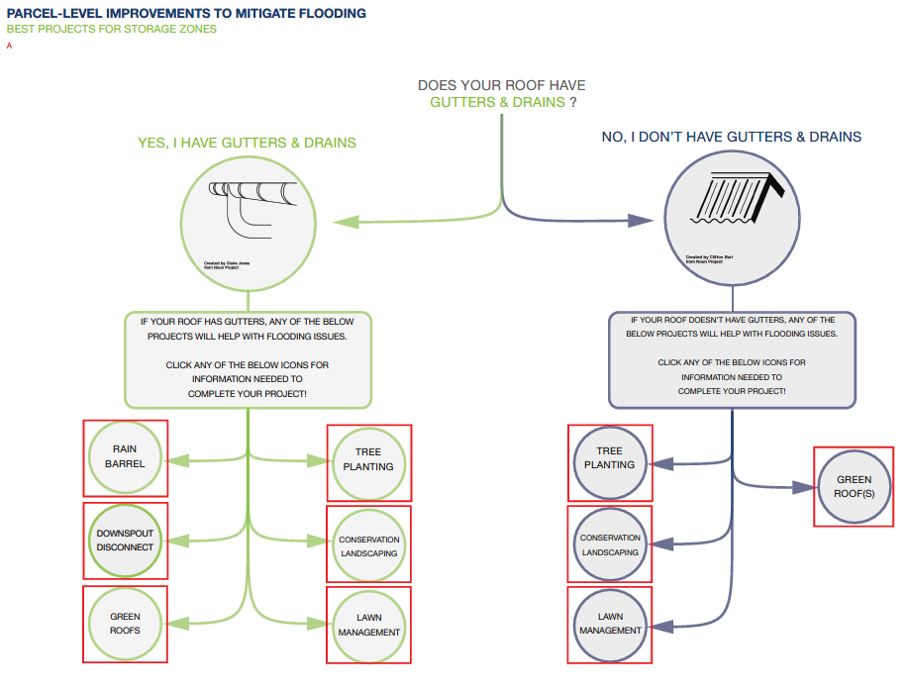
Community Resilience – Doing Your Part

Slide 7
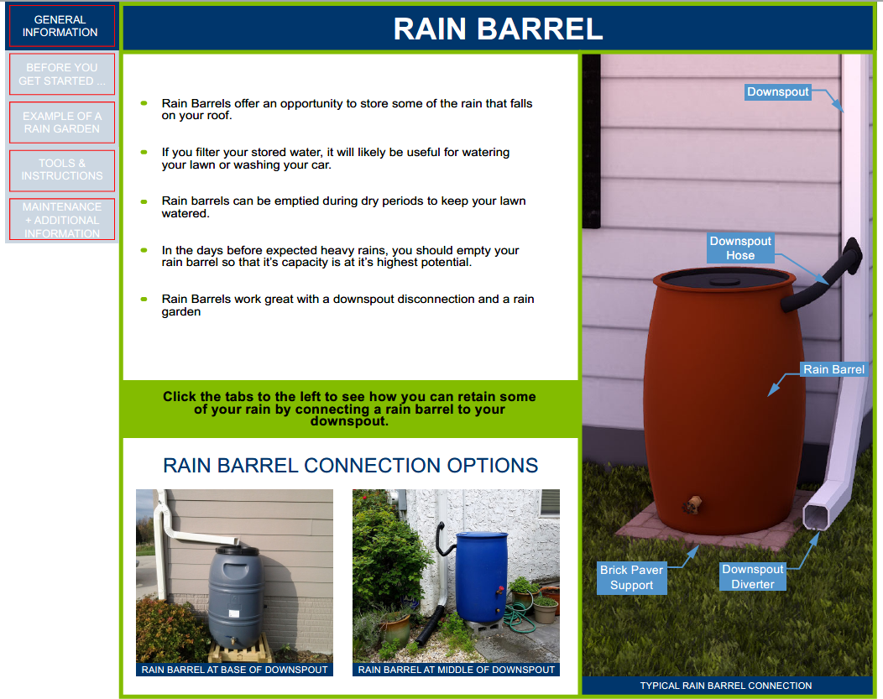

Slide 8

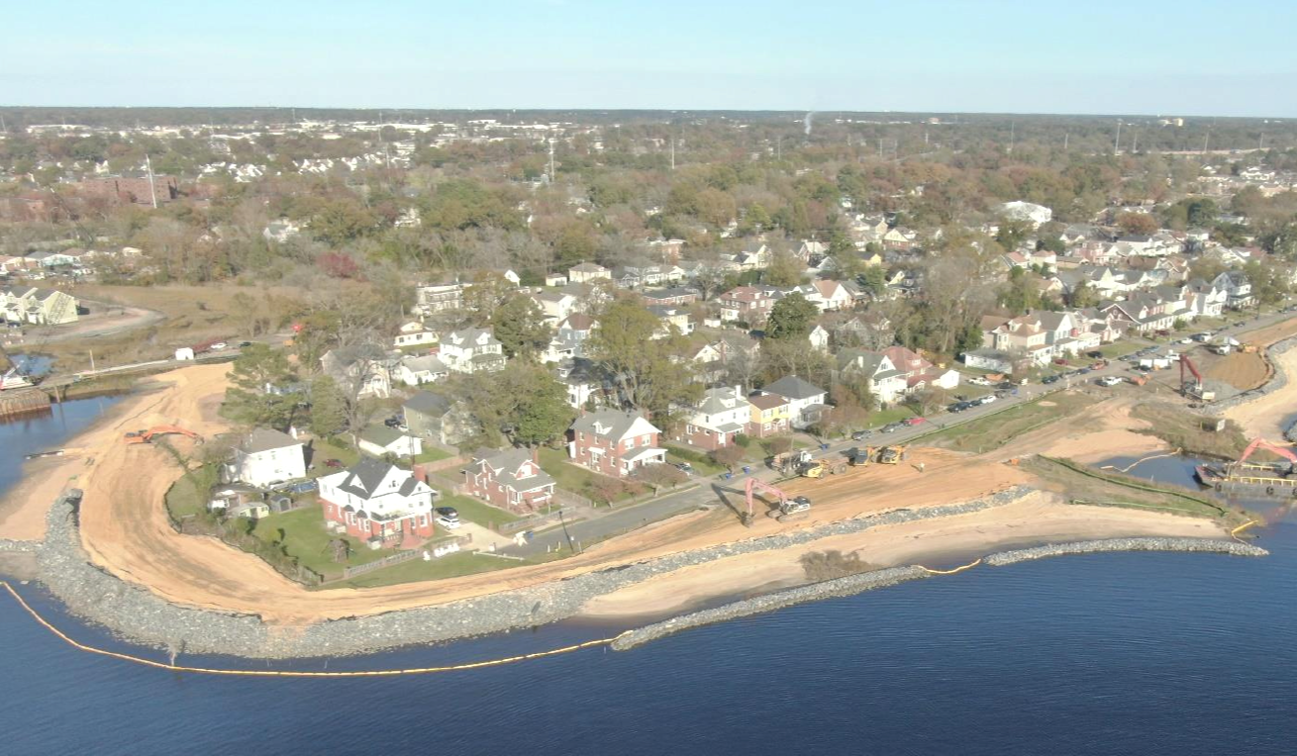
Thank You!
Kyle Spencer, Chief Resilience Officer
Kyle.Spencer@norfolk.gov

